Slide 1

AI Salary Projection Tool
Deployment of Ensemble Machine Learning for Predictive Compensation
Presented By: Ranjan Kumar Shaw
Guided By: Ms. Naina Devi

Slide 2
Project Agenda
01
02
Introduction & Problem Statement
Tools & Technologies Stack
Understanding why traditional salary estimation lacks accuracy and robustness.
Python, Flask, Scikit-learn, HTML/CSS/JavaScript for full-stack development.
03
04
Project Architecture & Working
Ensemble Model & Key Features
Client-server model enabling seamless frontend-backend communication.
Advanced voting regressor combining Random Forest and Gradient Boosting.
05
06
Demonstration & Output Screenshots
Challenges & Solutions
Live interface showcasing input validation and salary predictions.
Technical obstacles overcome through validation logic and ensemble methods.
07
08
Applications & Future Scope
Project Link & Q&A
Real-world impact in HR, career planning, and market analysis.
Final submission and open discussion on implementation details.

Slide 3
The Problem
Traditional salary estimation relies on subjective methods or simple linear regression. This approach lacks accuracy when predicting compensation for diverse professional profiles.
We address this through comprehensive feature analysis including years of experience, education level, and job title classification.
Our Solution
A full-stack web application deploying a high-accuracy ensemble machine learning model for immediate, reliable salary projections.
Our dataset derives from structured professional attributes containing proven compensation patterns and industry benchmarks.

Slide 4
Tools & Technologies
Machine Learning
Backend API
Scikit-learn: RandomForest, GradientBoosting, VotingRegressor for ensemble modeling.
Flask (Python): Lightweight framework for deploying the prediction endpoint.
Pandas & NumPy: Data manipulation and numerical computing.
Chosen for simplicity, efficiency, and ideal single-endpoint architecture.
Frontend
Architecture
HTML, CSS, JavaScript: Responsive, interactive user interface.
Two-Tier Client-Server: Clear separation of presentation and processing logic.
Enables real-time validation and asynchronous API communication.
Scalable design supporting future cloud deployment.

Slide 5

Project Working: System Architecture
Browser Frontend
User form inputs & validation
Salary Prediction Result
AJAX / Fetch
Salary Prediction Flow
Asynchronous call to /predict
High-contrast final output
Ensemble ML Model
Flask API Backend
Request handling & preprocessing
Random Forest + Gradient Boosting
Data Flow: User inputs travel asynchronously through the /predict endpoint to the ensemble model, returning predictions instantly.
Input & Validation Layer
Client-side JavaScript validation enforces logical constraints: Age ≥ Experience + 18, preventing unrealistic professional profiles from reaching the model.
Prediction Output
The voting regressor combines base models, delivering accurate predictions displayed with maximum visibility and clarity.

Slide 6
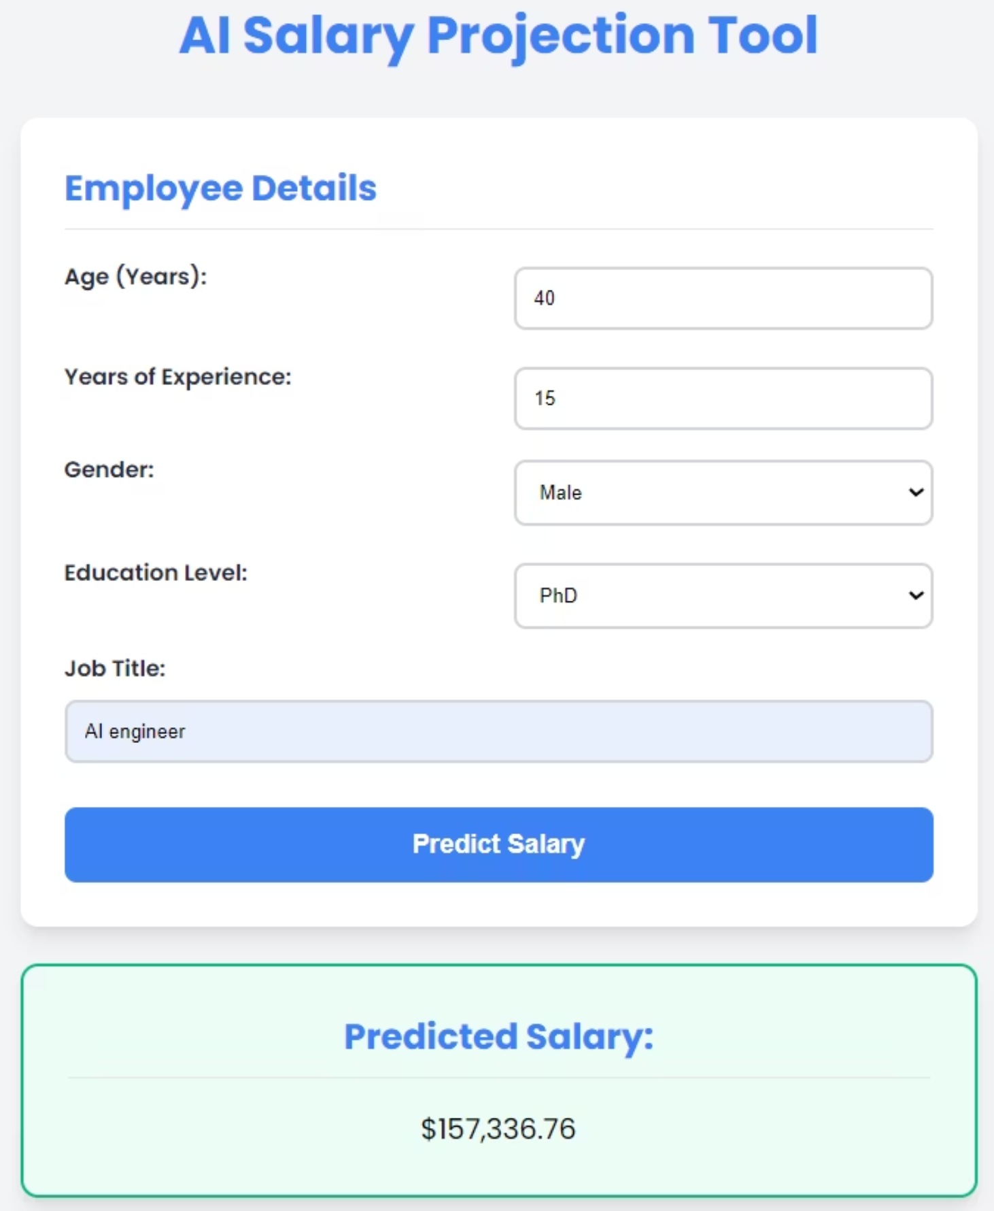
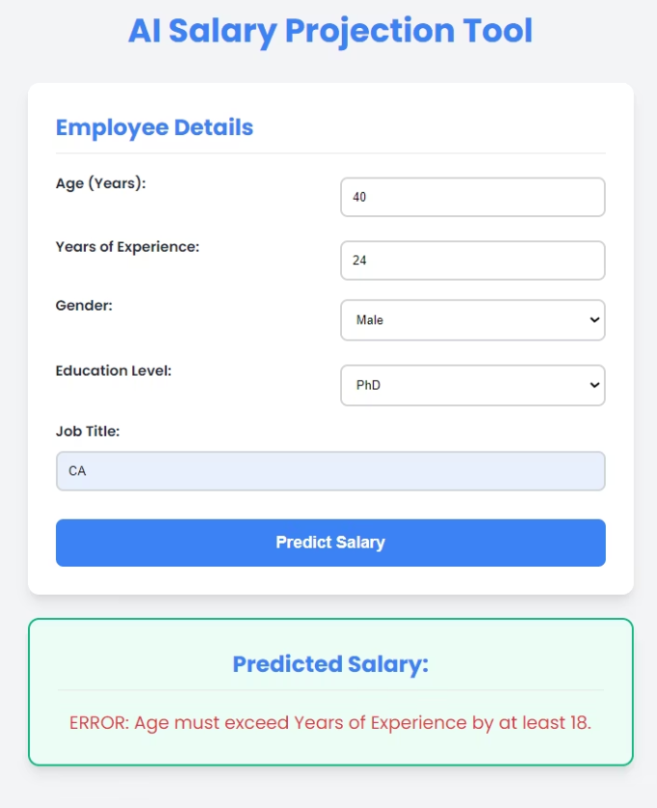
RESULTS :
HR & Recruitment
Career Planning
Market Analysis
Data-driven benchmarks establish competitive starting salaries and manage compensation bands efficiently.
Adaptable for tracking compensation trends across job titles and locations.
Professionals project earning potential based on education and experience choices.
Organizations make informed hiring decisions backed by predictive analytics.
Supports informed career development and strategic decision-making.
Enables longitudinal salary studies and industry benchmarking.

Slide 7
Challenges & Solutions
Model Accuracy Challenge
Data Quality Challenge
Interface Clarity Challenge
Problem: Reducing bias and variance for reliable predictions.
Problem: Preventing logically impossible inputs from reaching the model.
Problem: Ensuring salary predictions are clearly visible.
Solution: Implemented voting regressor combining Random Forest and Gradient Boosting for stabilized, high-accuracy predictions.
Solution: Flask-CORS enabled communication with forced CSS styling guaranteeing high-contrast result display.
Solution: Robust client-side JavaScript validation enforces real-world constraints like Age ≥ Experience + 18.

Slide 8

Future Scope & Enhancements
Model Enhancement
Integrate GridSearchCV for hyperparameter tuning, optimising Random Forest and Gradient Boosting settings.
Feature Expansion
Incorporate NLP analysis of job descriptions and external economic indicators enriching prediction features.
Cloud Deployment
Host on AWS or Azure for 24/7 global accessibility, scalability, and enterprise-grade reliability.
User Experience
Add industry comparison feature showing predicted salary against market benchmarks for entered job titles.

Slide 9

Thank You
Questions?
GitHub Repository
Contact Information
github.com/heyranianshaw07/AI-Salary-Projection-Tool
Ranjan Kumar Shaw
Email: heyranjanshaw

